Slide 1
Decoding behaviour from neural data using a dense nn
Omika Wadhwa, Kun Lin and Piyush Chauhan
Pod 141 Gregarious Sambar

Slide 2
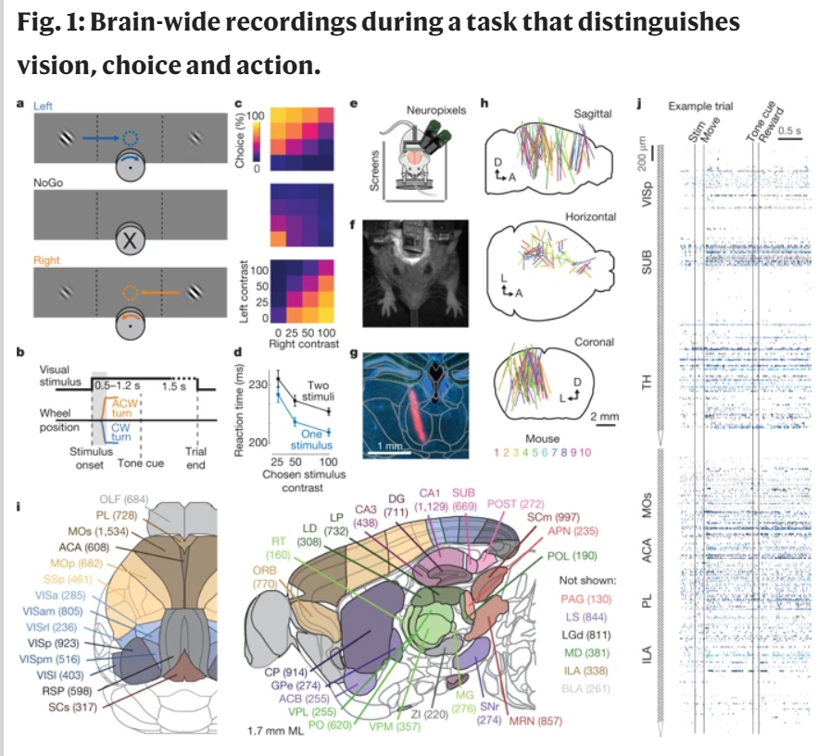
Steinmetz dataset

Slide 3
Research question
Prestimulus Activity
Visual Cortex
Behavioural Outcome
Visual Contrast

Slide 4
Research question
Motor Cortex
Prestimulus Activity
Visual Cortex
Behavioural Outcome
Visual Contrast

Slide 5
methodology
Temporal Profile of Information
Exploring the data
Train the DNN
Find the time point at which the neural activity from brain areas can be used to decode behavioural outcomes
Train the DNN using to predict the behavioural outcomes
Train multiple DNNs on data from different time points and compare the accuracy

Slide 6
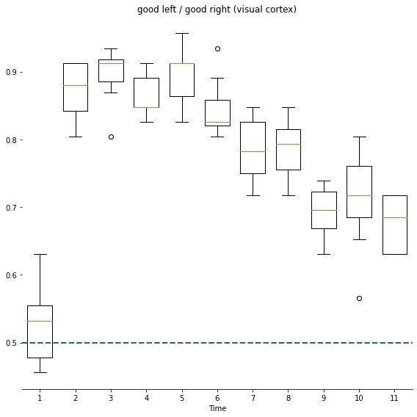
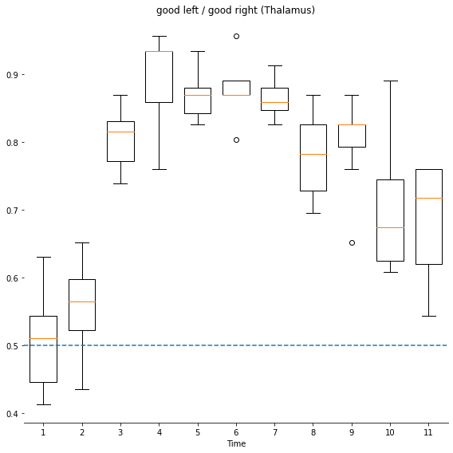
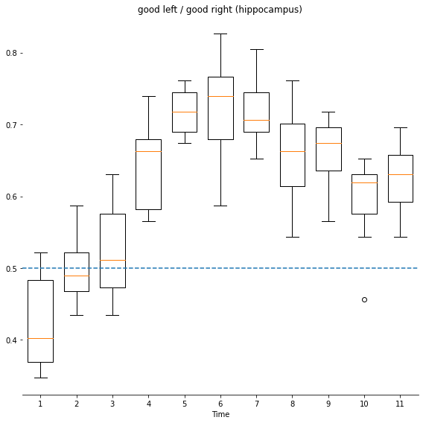
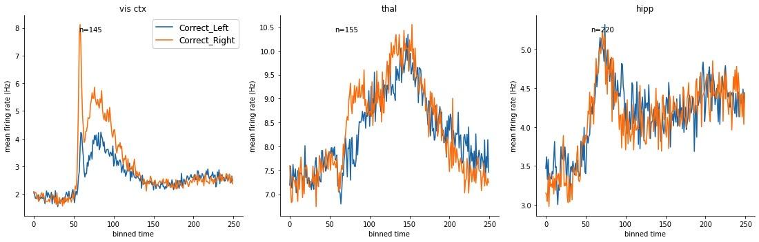
results
The performance of the model was maximum in the time bins when the stimulus was presented
(>90% for the visual cortex and thalamus and >80% for hippocampus)
Performance of the model as a function of time for the trials on which the mouse accurately discriminated between the right and the left contrast (No-Go trials not considered here)

Slide 7
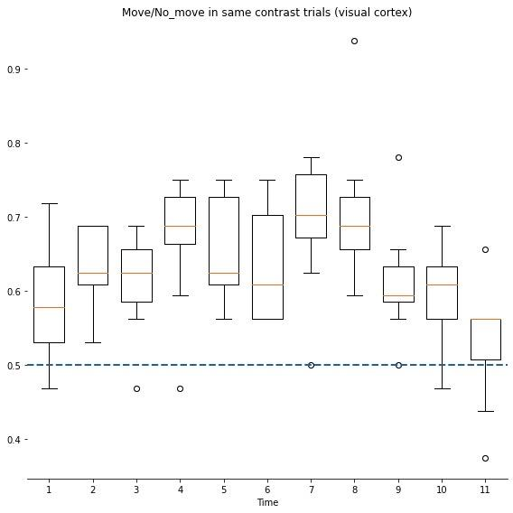
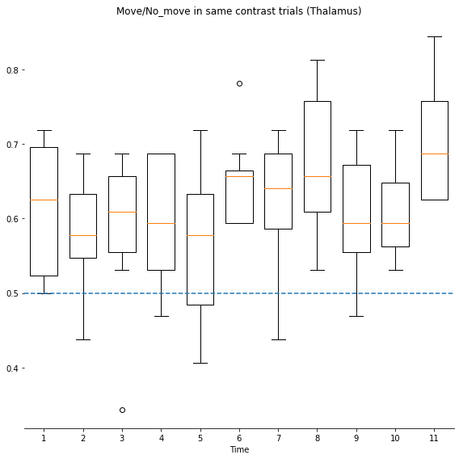
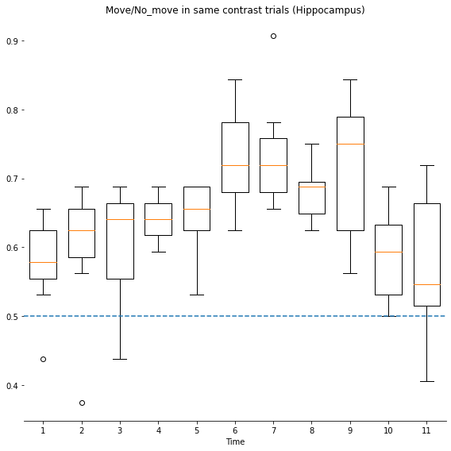
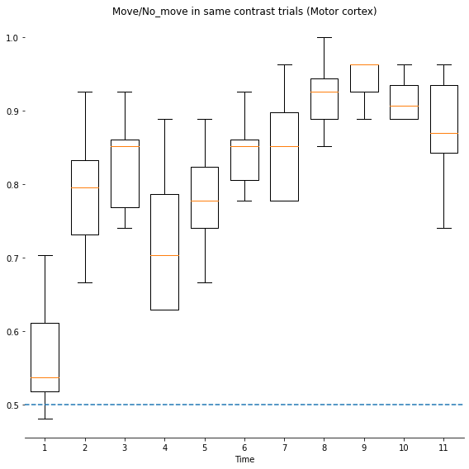
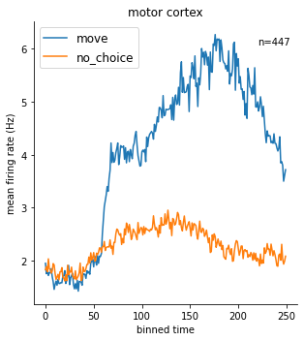
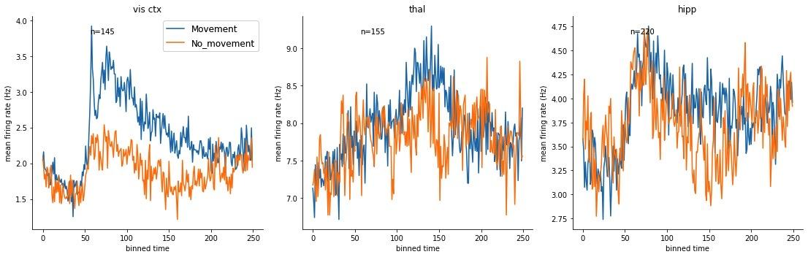
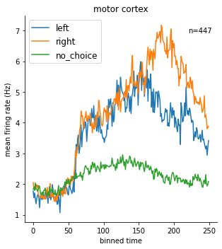
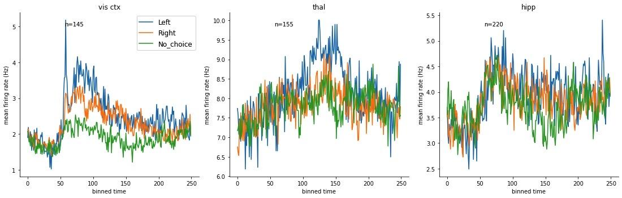
results
Performance of the model from trials when the mouse was shown the same contrast on both the sides (used to look at a neural signature of movement in brain areas)

Slide 8
conclusion
We confirm that the visual cortex contains information about the value of the stimulus presented (before movement onset)
We confirm that there a temporal component to this value information, and that maximum value occurs after stimulus onset
We confirm that there is a very good signature of movement in the motor cortex, and a weaker signature in other brain areas

Slide 9
We would like to thank
Our mentor, Dr. Nathalie Rochefort for her support and guidance through the project
Zane Mitrevica, for being an awesome TA
Dr. Patricio Orio for mentoring the initial project phase
The Steinmetz Lab for their Dataset
The Kording Lab, for their Neural Decoding ToolBox
Our whole pod, the gregarious sambars, for an amazing journey through NMA
And of course, the whole NMA community for giving us the opportunity to work on this project

